Slide 1
Elevating Competency
Leveraging Miller’s Pyramid for Clinical Success
Jennifer Kempa, CST-AAS, MSEd

Slide 2

Objectives
Define
Define Miller’s Pyramid
Describe
Describe the four levels of Miller’s Pyramid
Explore
Explore the integration of Miller’s Pyramid into lab and clinical competencies
Discuss
Discuss the benefits and challenges of using Miller’s Pyramid for grading lab and clinical competencies
Provide
Provide actionable strategies for implementing Miller’s Pyramid in grading frameworks

Slide 3

Miller’s Pyramid – History & Definition
Developed in 1990 by psychologist George Miller
Created to address the limitations of traditional medical education
Structural approach to assessing medical competence that also considers how a medical professional would behave in a real life clinical setting
Four levels
Knows
Knows How
Shows How
Does

Slide 4
Four Levels Explained
Does:
Assessed through direct observation in real clinical settings
Shows How:
Assessed through standardized patient exercises, simulations, and clinical exams
Knows How:
Assessed through essays, clinical problem-solving exercises, and extended multiple-choice questions
Knows:
Assessed through written exams and multiple-choice questions

Slide 5
Four Levels Integrated: Knows
Knows
Base level
Knowledge gained from didactic courses and assigned readings
Assessed through multiple choice exams
Example
Formative questions integrated into lectures as a method of engagement
When presented with a situation can discuss the facts, but cannot perform the task
Creating a sterile field

Slide 6
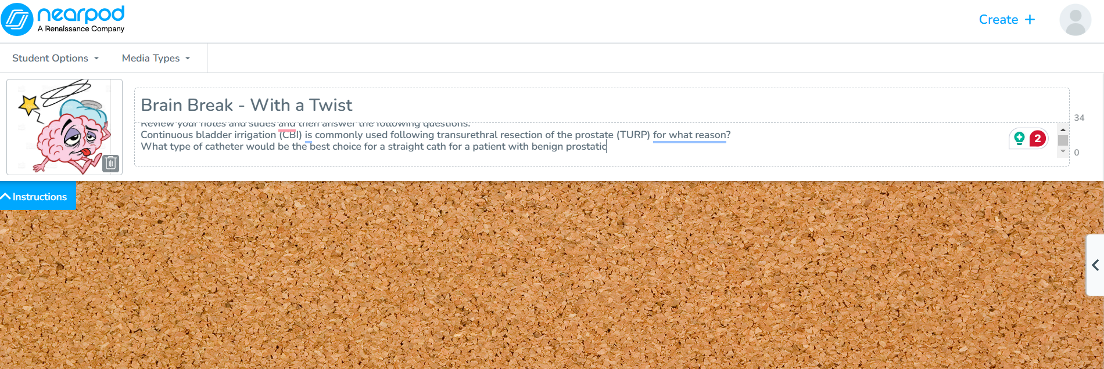
Four Levels Integrated: Knows
Integration example - Lecture
  After every 4 or 5 slides during a lecture I add a “brain break”
  Allows students time to organize their notes and ask clarifying questions
  Integrated questions make them review their notes and repeat back the information

Slide 7
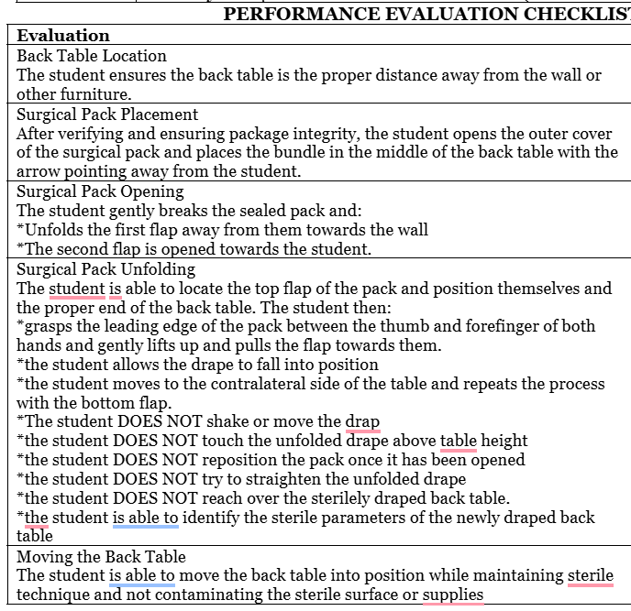
Four Levels Integrated: Knows
Integration Example – Lab: Creating a Sterile Field

Slide 8

Four Levels Integrated: Knows How
Knows How
Second level
Knowledge can be applied in case-based scenarios
Assessed through essay questions and case studies
Can perform the task but needs prompting
Example
Open ended questions embedded in lectures that have students apply the information
Group case studies
Creating a sterile field through the opening of a back table pack

Slide 9
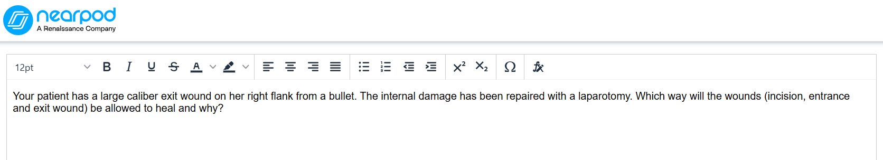
Four Levels Integrated: Knows How
Integration Example - Lecture
  Before moving on to a next lecture objective I embed an open ended question in the form of a case study or a poll
  Requires students to apply the information to answer

Slide 10
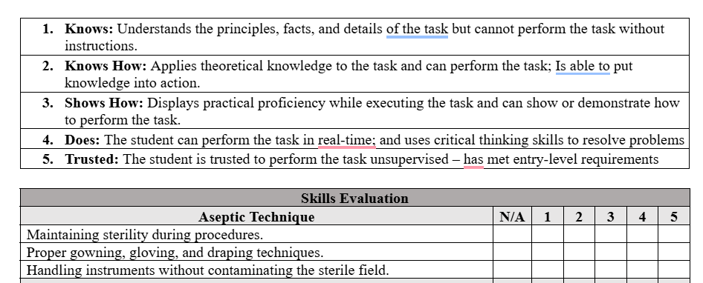
Four Levels Integrated: Knows How
Integration Example: Lab
  Stand alone competency testing
  Weekly lab evaluations

Slide 11
Four Levels Integrated: Shows How
Shows How
Can apply the information or perform the task but lacks critical thinking capabilities
Assessed through summative assessment or competency based testing
Stand alone competency testing
Example
Creating a sterile field and stating the boundaries
Summative assessments at the end of a unit or chapter

Slide 12
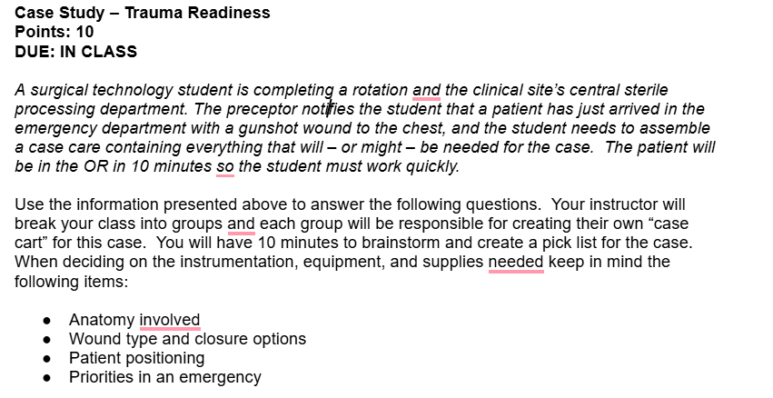
Four Levels Integrated: Shows How
Integration Example – Lecture
  Case studies with peers with guided questions

Slide 13
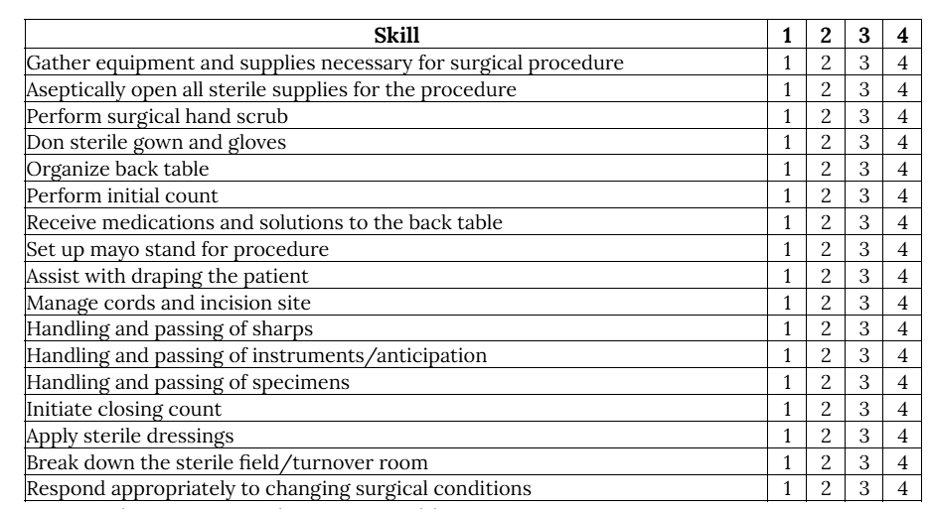
Four Levels Integrated: Shows How
Integration Example – Lab
  Lab practical testing where students must combine all skills into one fluid application in the lab

Slide 14
Four Levels – Integrated: Does
Does
The “highest” level
The student can apply the information or perform the task with proficiency
Can use critical thinking skills to apply prior knowledge to the situation
Assessed through high stakes examinations like the CST exam
Evaluations in the clinical setting by preceptors
Example
Passing score on the CST exam
Performing in the first scrub role in clinical

Slide 15

Four Levels Integrated: Does
Integration Example – Lecture
  Continued improvement on CST practice exam testing
  Summative assessment at the end of a lecture

Slide 16
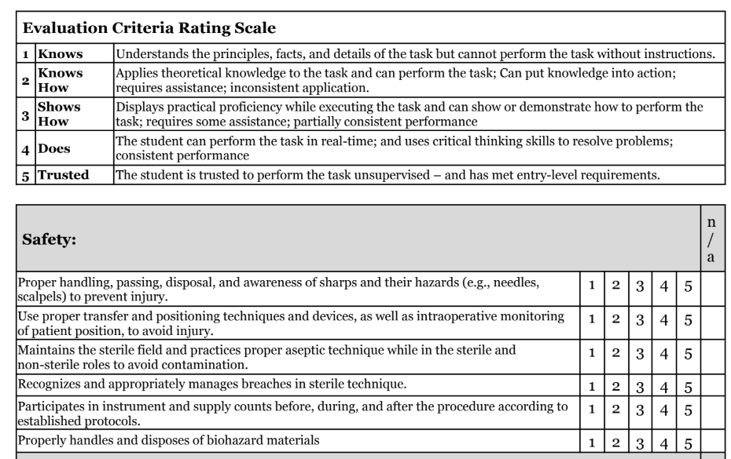
Four Levels Integrated: Does
Integration Example – Clinical
  Preceptor evaluations upgraded to include Miller’s pyramid descriptions instead of standard Likert Scale grading

Slide 17
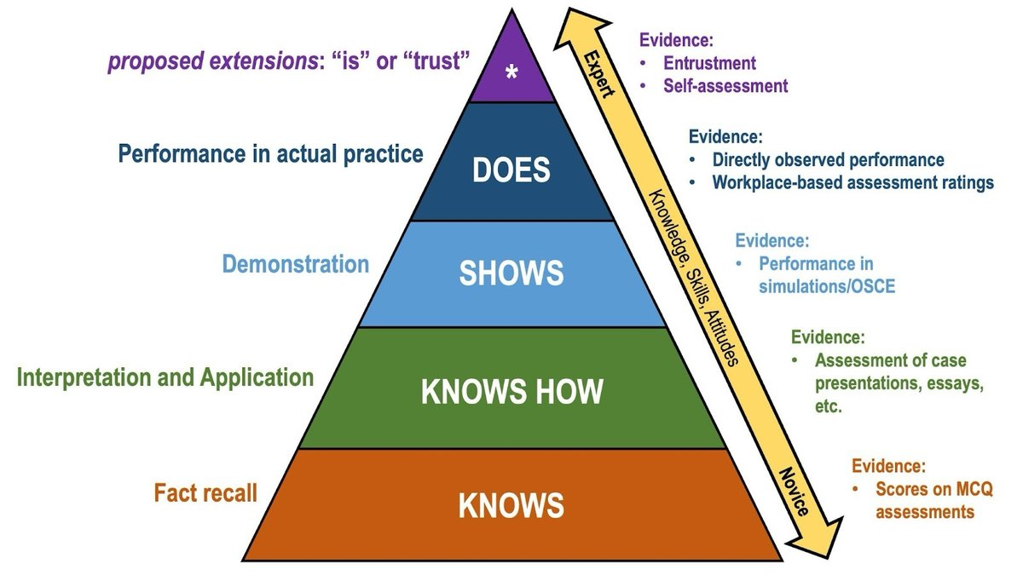
The 5th Level
A modified version of Miller’s Pyramid adds a 5th level – IS
Students at this level display the affective, cognitive, and psychomotor characteristics of a professional
“Has met requirements to be considered an entry-level practitioner”

Slide 18

Integration Benefits
Clearer evaluation objectives
  Combining Miller’s Pyramid with UbD framework
Structured progression from knowledge to real-world application
Aligns with the movement towards Competency Based Medical Education (CBME)

Slide 19
Integration Challenges
Subjectivity…
Require specificity with outcome descriptions in each level
Inter-rater reliability
Require competent faculty to perform assessments
Necessitate subject matter expertise

Slide 20
Implementation Tips
Align assessments with objectives
Specify measurable outcomes for each competency
Faculty development
Provide “calibration” sessions to improve consistency and reduce bias
Transparent rubric for grading
Review rubrics with students to help guide their preparation
Provide continuous feedback/encouragement
Integrate formative feedback loops
Provide written comments

Slide 21
Your Turn
Miller’s pyramid will allow for improvement in accuracy when assessing student skill acquisition
Gives instructors specific behaviors to assess
Gives students specific behaviors to perform
Review your competencies and evaluations
Look for issues with specificity
Discuss needs with faculty

Slide 22
Resource List
Witheridge A, Ferns G, Scott-Smith W. Revisiting Miller's pyramid in medical education: the gap between traditional assessment and diagnostic reasoning. Int J Med Educ. 2019 Oct 25;10:191-192. doi: 10.5116/ijme.5d9b.0c37. PMID: 31655795; PMCID: PMC7246123.
Cruess, Richard L. MD; Cruess, Sylvia R. MD; Steinert, Yvonne PhD. Amending Miller’s Pyramid to Include Professional Identity Formation. Academic Medicine 91(2):p 180-185, February 2016. | DOI: 10.1097/ACM.0000000000000913
Baker College Surgical Technology Program – Weekly Evaluation
Baker College Surgical Technology Program – Preceptor Evaluations

